Slide 1

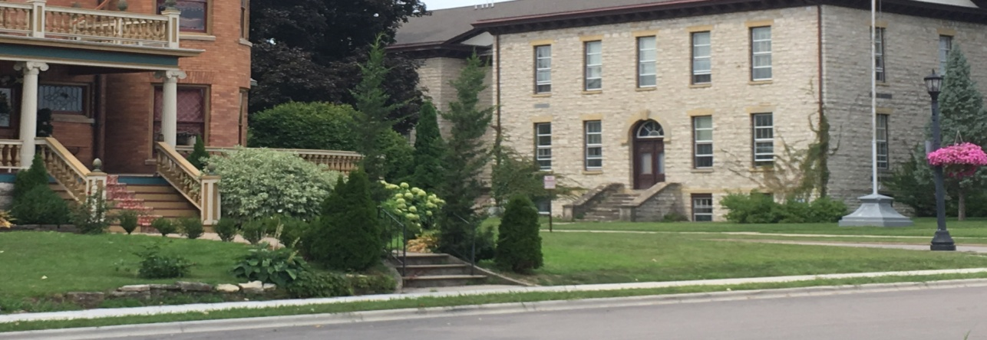

City of Platteville Housing Study
March 12, 2019

Slide 2
Housing Study – Product & Process
Process
  Vierbicher hired Spring 2018
  Steering Committee Formed
  On-Line & Paper Survey sent out community-wide
  Stakeholder Interviews conducted
  Previous & Existing Plans Referenced
  Housing Market Data compiled
  Issues, Opportunities, & Strategies formed from survey, data, stakeholder interviews & Steering Committee input
  Public Meeting @ School District
Product - Housing Study Chapters & Appendices
  Chapter 1 – Municipal Initiatives
  Chapter 2 – Housings Rehabilitation
  Chapter 3 – Infill Construction & New Development
  Chapter 4 – Funding Initiatives
Questions/Comments

Slide 3
Steering Committee
City Staff
Platteville Area Industrial Development Corporation
Southwest General Health Center
Platteville School District

Slide 4
On-line Public Survey
Respondent Review
Zone of Residence
Tenure
Owner Households Cost
Renter Households Cost
Housing Type
Household Type
Income & Cost
Employment
Housing Stock
Renter Households Satisfaction
Owner Households Investments
Community
Preferences
Platteville Housing Needs

Slide 5
Stakeholder Interviews
Realtors
Landlords
Builders/Developers
Financial Institutions
City Representatives
University of Wisconsin – Platteville
Economic Development Partners

Slide 6
Housing Market Analysis
Population
Households
School Enrollment
Income
Tenure
Housing Costs
Vacancy
Housing Stock

Slide 7
Housing Market Analysis
Population Growth by Generation
Baby Boomers, Generation X, and Generation X and Generation Y all increased their share of the population during this time period. For purposes of this study, the Silent Generation are considered to be those 70 and older, Baby Boomers are 50 to 69, Generation X are 35 to 49, Generation Y are 20 to 34, and Generation Z are those under 20.
The Silent Generation and Generation Z both declined as a percentage of the Platteville population during this time period. However, the percentage of children under the age of five (5) actually increased, which will result in the need for housing with enough bedrooms for larger families in the medium to long term.

Slide 8
Housing Market Analysis
Household Size
Household size for Platteville was smaller than the County and State in 2011; however, household size grew by 4.6% during this time period to reach a 2.48. This further shows the need for family housing in the near and medium term.

Slide 9
Housing Market Analysis
Tenure by Percent
Census vacancy rates by type shows the majority, 56.4%, of Platteville’s vacancies are for-rent, which is much higher than for the County or State. The second highest vacancy type includes those that are sold, yet not occupied. This could show there are houses with are too expensive to rehabilitate and not being put on the market.
Platteville also has an issue with a percentage of renters that is too high and a percentage of owners that is too low. Therefore, this represents an opportunity to convert vacant for-rent housing units into for-sale housing units through rehabilitation and re-introduction to the housing market without fear of affecting the rental market and rental availability.
Vacancy Rates by Tenure, 2011 & 2016

Slide 10
Housing Market Analysis
Looking at future generations, those in the 19 or less, 35 to 49 and 65+ age groups are expected to gain in population. The growth in the 19 and under age bracket will increase the need for housing families with school-aged children. The growth in those aged 35 to 49 will create continued pressure for more workforce housing for young professionals and an increase in the number of seniors will create the need for senior housing in the medium to long-term.
Projections by Age

Slide 11
Housing Market Analysis
Platteville’s population is projected to increase to 12,514 by 2023 and 13,547 by 2033. This represents an overall growth rate of over 10% from now to 2033.
Population Projections

Slide 12
Chapters & Appendices
Chapters Defined by Topic
Chapter 1 – Municipal Initiatives
Chapter 2 – Housing Rehabilitation
Chapter 3 – Infill Construction & New Developments
Chapter 4 – Funding Initiatives
Appendices
Appendix A – Survey Results
Appendix B – General Demographic & Housing Data
Appendix C – Chapter Specific Demographic & Housing Data

Slide 13
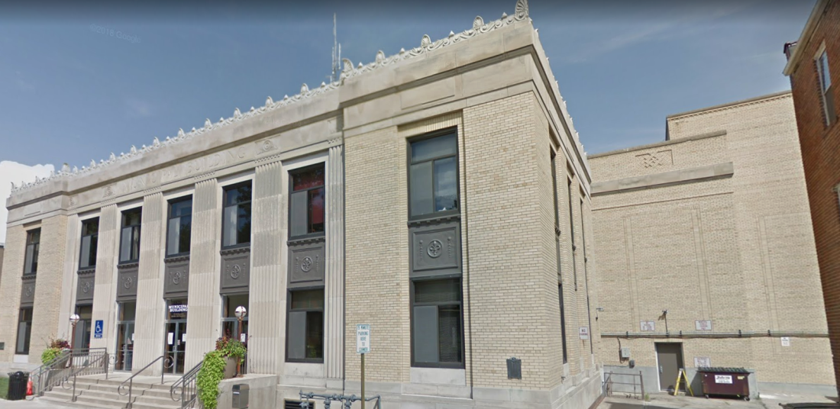
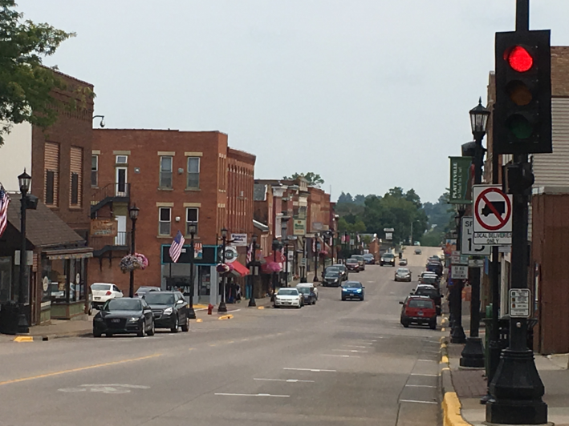
Chapter 1 – Municipal Initiatives
Municipal Initiatives Goal
To accomplish objectives and strategies which are comprehensive, address current planning efforts, and prepare the City to work with housing partners to complete the specific objectives and strategies which will enable the City to respond to identified needs and build a range of housing types for a wide range of income levels.

Slide 14
Chapter 1 – Municipal Initiatives
Municipal Initiatives Objectives
High Priority (Priority 1 & 2)
Medium Priority (Priority 3 & 4)
Low Priority (Priority 5 & 6)
Allow for multi-family attached housing and apartments in commercial districts
Create Mixed-Use zoning district
Amend Proposed Land Use Plan to encourage multi-family housing in commercial areas
Amend Proposed Land Use Plan to encourage more multi-family attached housing
Expand Historic District(s) Area
Establish and fund a Neighborhood planning program

Slide 15
Chapter 1 – Municipal Initiatives
Municipal Initiatives Objectives
High Priority (Priority 1 & 2)
Medium Priority (Priority 3 & 4)
Low Priority (Priority 5 & 6)
Create mixed housing-type/smaller lot residential district
Coordinate Annual Round-Table discussions with housing related professionals
Expand existing development authority coverage area
Encourage developer/builder participation in local, state, federal housing assistance and initiatives
Establish coordinated homebuyer and other counseling to meet existing and new funding source requirements
Evaluate effectiveness of current improvement-based assessment schedule
Evaluate effectiveness of current impact fee program

Slide 16
Chapter 1 – Municipal Initiatives
Municipal Initiatives Strategies

Slide 17
Chapter 1 – Municipal Initiatives
Municipal Initiatives Strategies

Slide 18
Chapter 1 – Municipal Initiatives
Municipal Initiatives Strategies

Slide 19
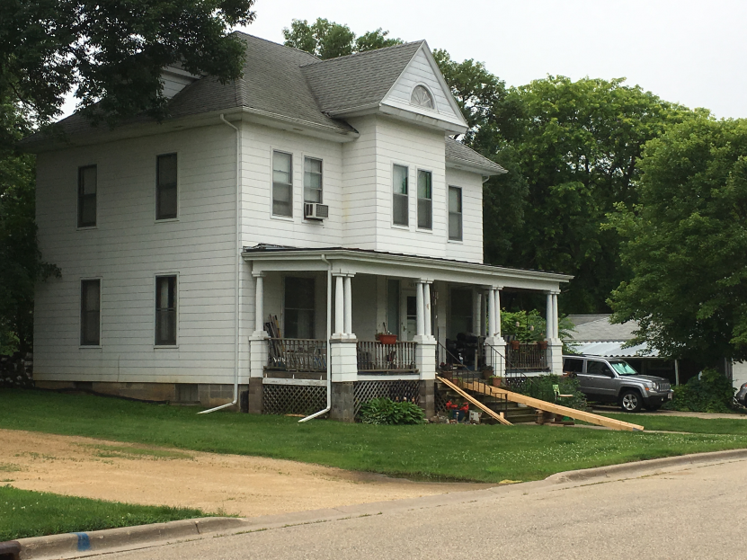
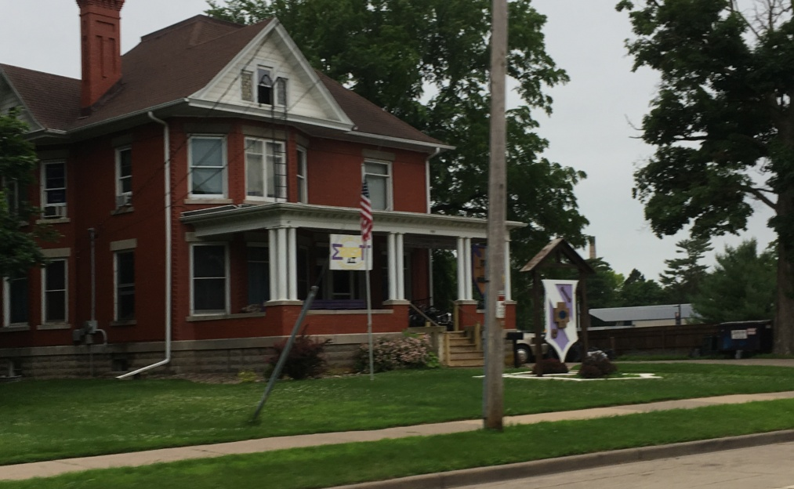
Chapter 2 – Housing Rehabilitation
Housing Rehabilitation Goal:
To provide direction, assistance, and incentives which encourage the rehabilitation of houses which are needed to satisfy the existing and future housing demand for a range of housing types and income levels.

Slide 20
Chapter 2 – Housing Rehabilitation
Housing Rehabilitation Objectives
High Priority (Priority 1 & 2)
Medium Priority (Priority 3 & 4)
Low Priority (Priority 5 & 6)
Expand Existing and Establish Additional Home Rehabilitation Programs
Protect existing housing stock from further rental conversion
Encourage home rehabilitation through acquisition of code violation, unhealthy, foreclosed, and/or abandoned properties
Expand Main Street Program initiatives
Expand Main Street Program initiatives
Expand Historic Preservation Commission Efforts

Slide 21
Chapter 2 – Housing Rehabilitation
Housing Rehabilitation Strategies

Slide 22
Chapter 2 – Housing Rehabilitation
Housing Rehabilitation Strategies

Slide 23
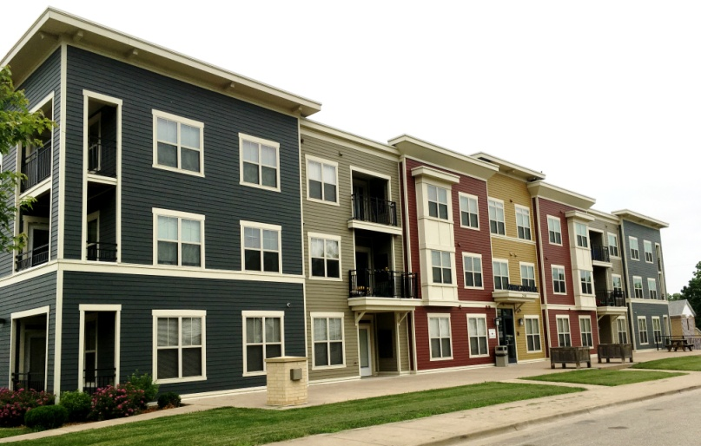
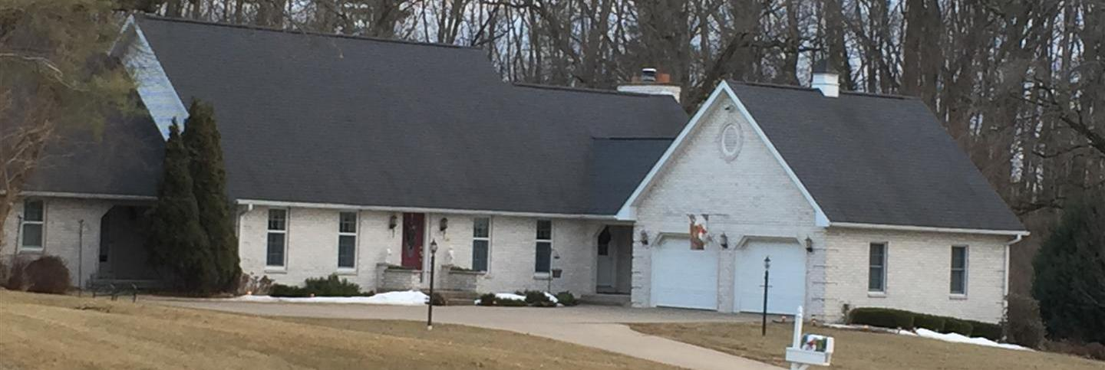
Chapter 3 – Infill Construction and New Development
Infill Construction and New Development Goal:
To provide direction, assistance and incentives which encourage the construction of houses which are needed to satisfy the existing and future housing demand for a range of housing types and income levels by increasing the supply of buildable site, the affordability of land development and the market exposure of available sites to potential builders, developers and non-profit housing partners.

Slide 24
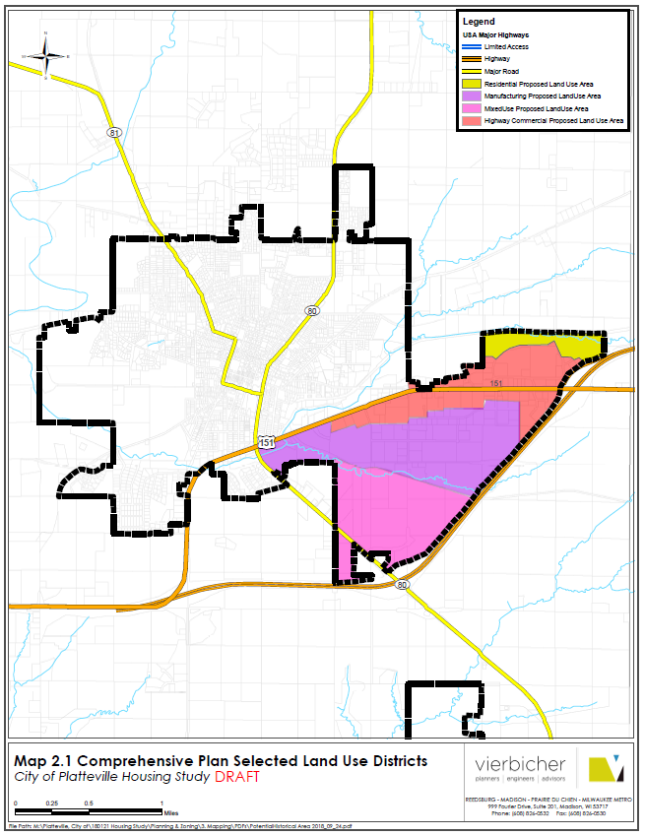
Land Use Districts with Potential for New Housing Developments
Residential Land Use Area
Commercial Land Use Area
Manufacturing Land Use Area
Mixed-Use Land Use Area

Slide 25
Chapter 3 – Infill Construction and New Development
Municipal Initiatives Objectives
High Priority (Priority 1 & 2)
Medium Priority (Priority 3 & 4)
Low Priority (Priority 5 & 6)
Encourage housing construction through site preparation assistance
Directly provide off-site and on-site improvements to encourage housing construction
Create off-site and/or on-site improvements grant/loan program to encourage housing development construction
Increase supply and utilization of available land and proactively encourage home construction
Expand Main Street Program initiatives
Proactively work with developers and investors to build identified housing projects on target properties

Slide 26
Chapter 3 – Infill Construction & New Development
Infill Construction & New Development Strategies

Slide 27
Chapter 3 – Infill Construction & New Development
Infill Construction & New Development Strategies

Slide 28
Chapter 3 – Infill Construction & New Development
Infill Construction & New Development Strategies

Slide 29
Chapter 3 – Infill Construction & New Development
Infill Construction & New Development Strategies

Slide 30
Chapter 4 – Funding Initiatives
Funding Initiatives Goal:
To encourage greater current and future utilization of Local, State, Federal, and other housing-related funding programs in order to encourage the housing rehabilitation and construction projects which result in more affordable housing stock and which provide more financial assistance options to renters and home buyers.

Slide 31
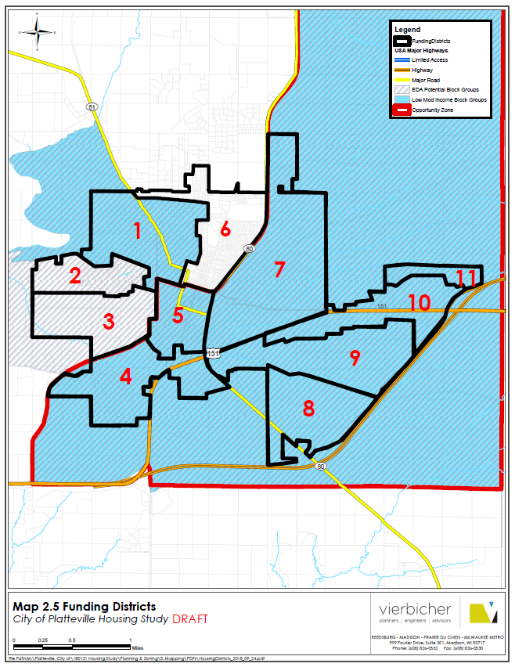
Funding Districts
Notes:
State why these shapes are the way they are even though they may want to change the boundaries for how they think they should be. We are tied to funding sources.

Slide 32
Chapter 4 – Funding Initiatives
Funding Initiatives Objectives
High Priority (Priority 1 & 2)
Medium Priority (Priority 3 & 4)
Low Priority (Priority 5 & 6)
Expand access to HUD HOME program funding
Expand access to HUD CDBG program funding
Expand effectiveness of HUD funding utilization
Expand existing development authority initiatives
Expand Main Street Program initiatives
Establish public/private partnerships to access additional funding
Expand Historic Preservation Commission Efforts

Slide 33
Chapter 4 – Funding Initiatives
Funding Initiatives Objectives
High Priority (Priority 1 & 2)
Medium Priority (Priority 3 & 4)
Low Priority (Priority 5 & 6)
Evaluate potential for current TIF districts to fund housing projects
Assist Community Development Corporation (CDC) to rehabilitate and build housing
Coordinate with SWWRPC to promote local housing programs/projects as part of CEDS
Establish coordinated homebuyer counseling to meet existing and new funding source requirements

Slide 34
Chapter 4 – Funding Initiatives
Funding Initiatives Strategies

Slide 35
Chapter 4 – Funding Initiatives
Funding Initiatives Strategies

Slide 36
Chapter 4 – Funding Initiatives
Funding Initiatives Strategies

Slide 37
Chapter 4 – Funding Initiatives
Funding Initiatives Strategies

Slide 38
Chapter 4 – Funding Initiatives
Funding Initiatives Strategies

Slide 39
Questions & Comments

