Slide 1
ART HALL

Slide 2
Welcome & Thank you!
Tonight’s Agenda
Art Hall at Legion Park – a brief history
Art Hall Today
Uses
Challenges
Art Hall Tomorrow
What about Repair?
Possible Features of a Replacement
Resource – Development & Acquisition
Questions
Next steps
Notes:
Welcome all and thank folks for attending (which shows interest in our parks and this building).
Introduce the various presentors….me as MC, Luke as ‘the keeper of the hall’, Gene as the ‘resource agent’
Review the agenda:
Brief history
Current uses of and state of the hall
What is possible?
replacement
renovation
Replacement requires resources
Process to acquire resources
Questions?
Next steps (form to provide feedback, indicate interest, participation)

Slide 4
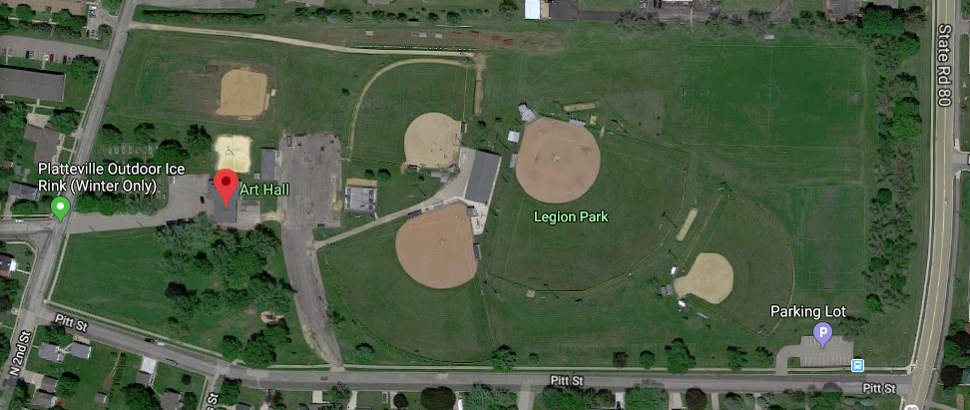

Slide 5
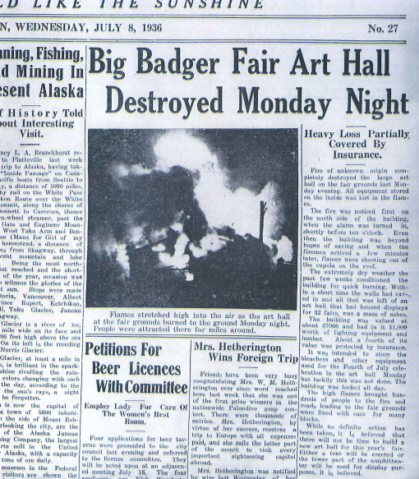
A Brief History
The original Art Hall was contracted in 1900 and later burnt in 1936.
The current facility was constructed sometime soon after.
The land, and presumably building, were purchased by the City from the Platteville Fair Association as part of a land acquisition in 1959. The land was purchased for public, recreational, or educational purposes.
Outdoor canopy was added onto the structure in 1984.

Slide 6
Current Usage
Family Reunions
Graduation Parties
Wedding Receptions
Business Gatherings
Church Groups
Auctions
Southwest Health Berry Fest
Dairy Days
Jaycees Easter Egg Hunt
Jaycees Haunted House
Kiwanis Chicken Dinner
Platteville Horseshoe Association State Tournament
UW-Platteville Groups
School District Groups
Girl Scouts
Ice Cream Social
Fire Department Picnic

Slide 7
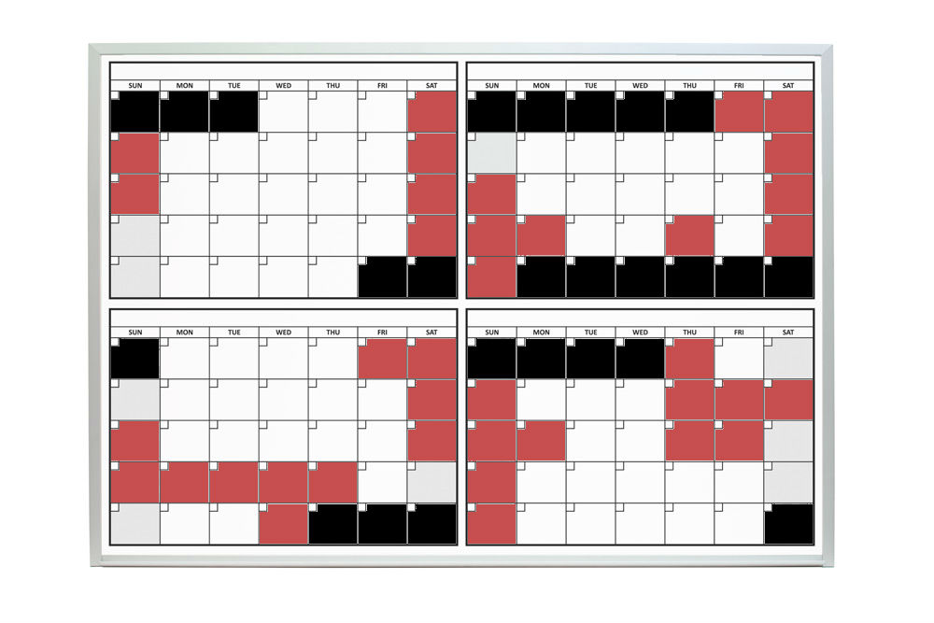
2016 JUNE, JULY, AUGUST & SEPT
38 Total Rentals
23 of 32 Saturdays & Sundays

Slide 8
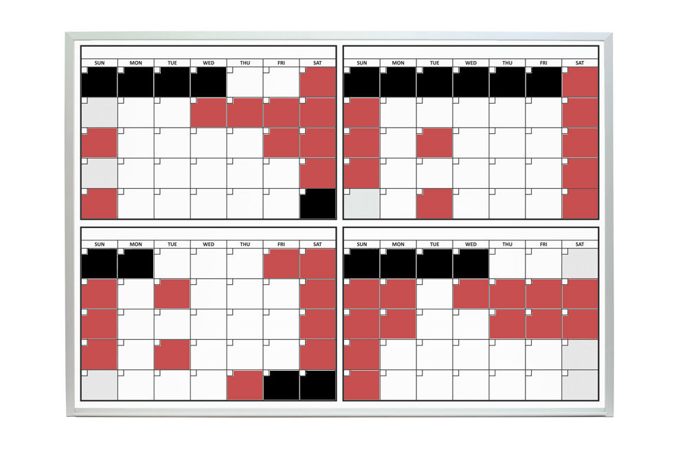
2017 JUNE, JULY, AUGUST & SEPT
44 Total Rentals
27 of 34 Saturdays & Sundays

Slide 9
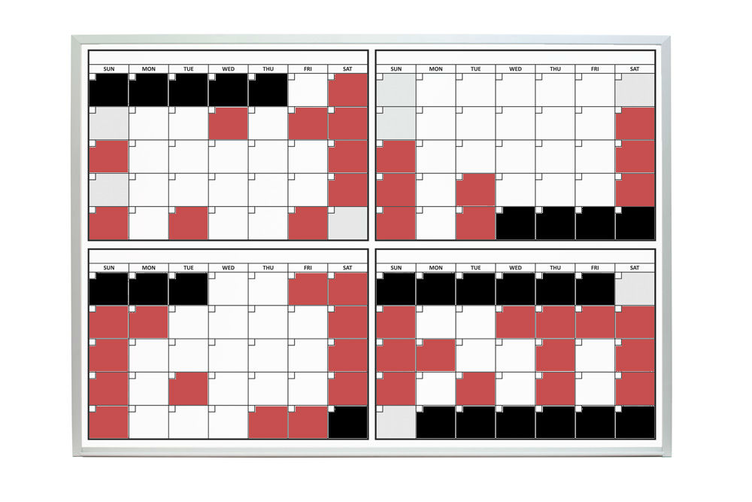
2018 JUNE, JULY, AUGUST & SEPT
44 Total Rentals
26 of 34 Saturdays & Sundays

Slide 10
What issues are limiting the usefulness of the current Art Hall…
It is not heated, so the bulk of our rental requests come during the months of June, July, August, and September.
It is too small to handle larger events, including Platteville Dairy Days. They are currently spending $3,000 per year on an entertainment tent.
The current facility has no restrooms or potable water.
There are cosmetic and structural issues with the existing building.

Slide 11
Structural Issues
The existing foundation is showing signs of settlement and failure.

Slide 12
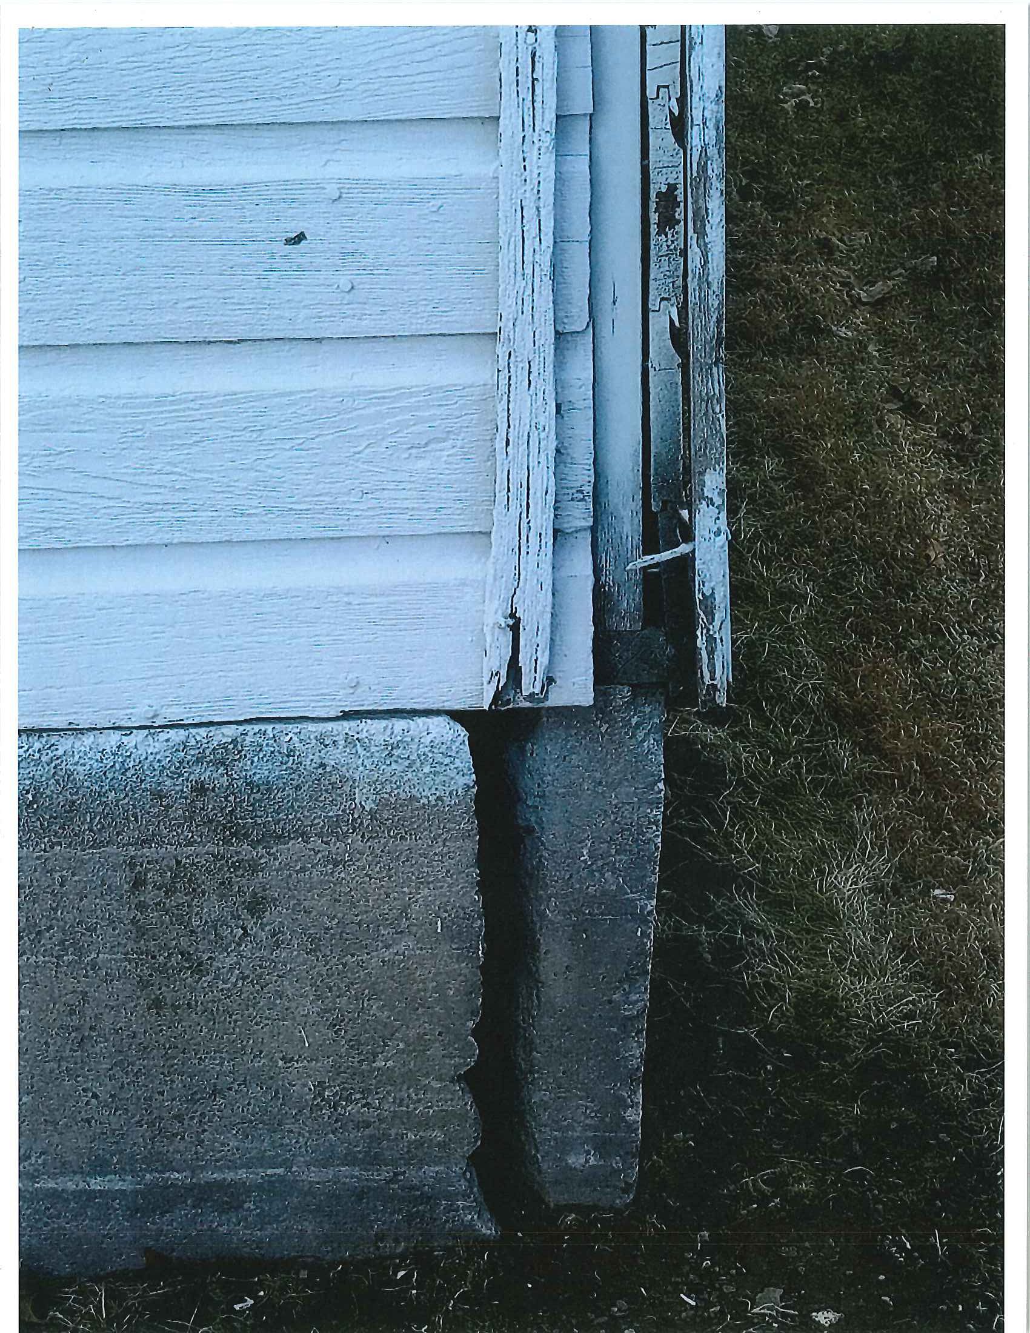
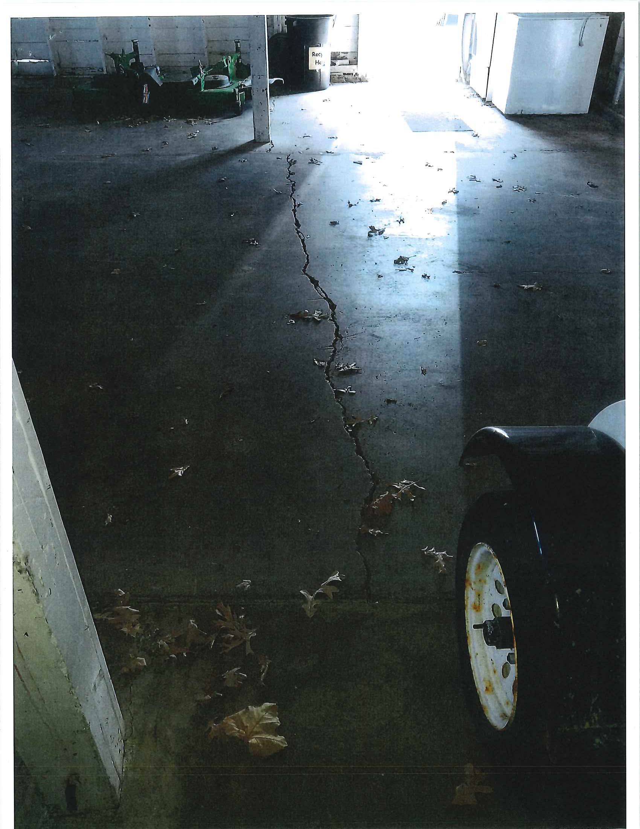

Slide 13
Structural Issues
The existing foundation is showing signs of settlement and failure.
The walls are separating from the foundation, many windows are broken, doors are rotting, and paint is chipping off. Repainting the building without first stripping is impractical. Even then, it is unlikely the paint would adhere well to the weathered wood.

Slide 14
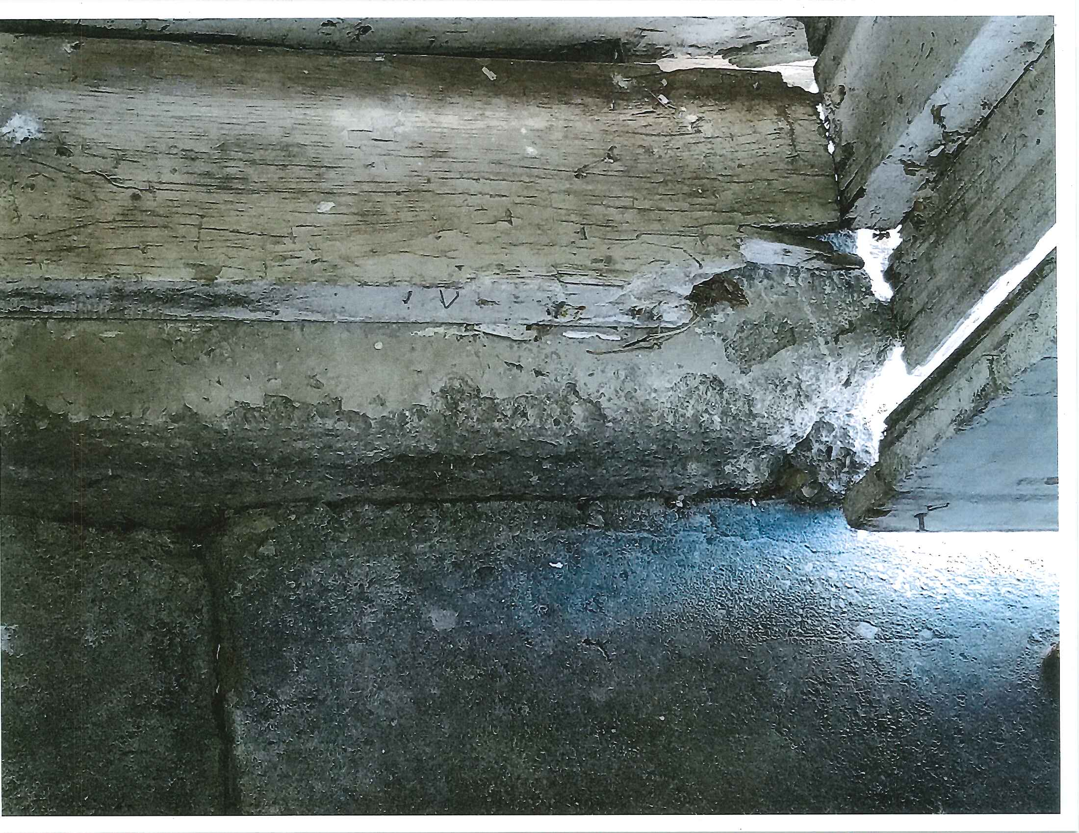
Cosmetic & Structural Issues

Slide 15
Structural Issues
The existing foundation is showing signs of settlement and failure.
The walls are separating from the foundation, many windows are broken, doors are rotting, and paint is chipping off. Repainting the building without first stripping is impractical. Even then, it is unlikely the paint would adhere well to the weathered wood.
The edge of the roof is showing signs of decay and the roof itself is settling along the east side of the structure.

Slide 16
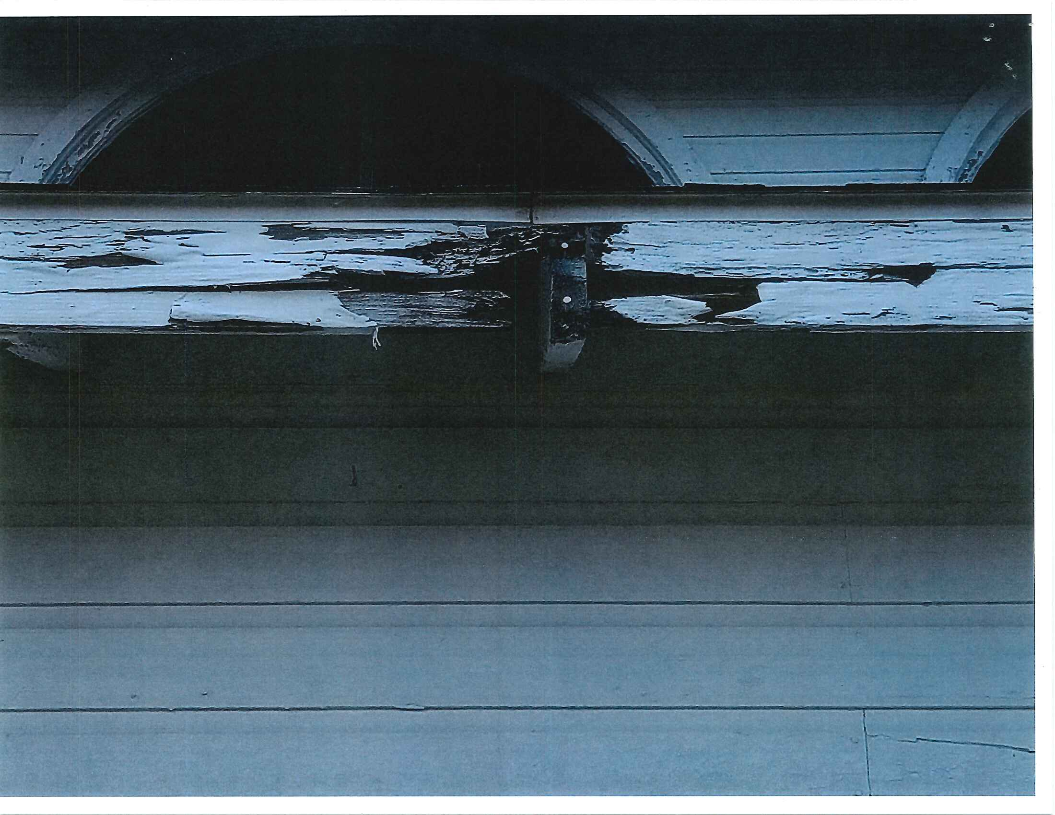

Slide 17
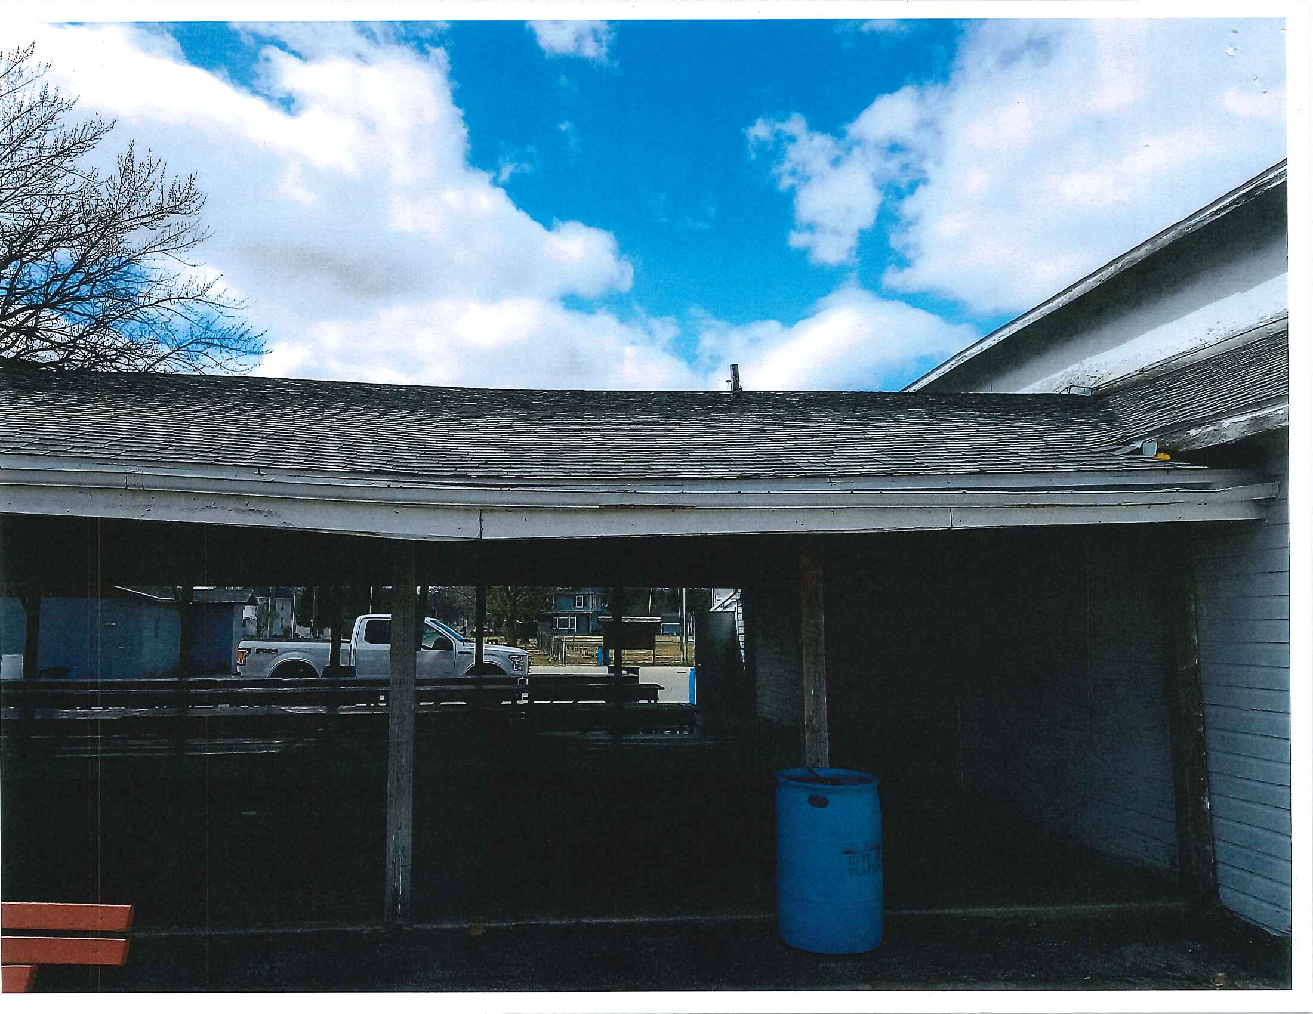

Slide 18
Can the existing facility be repaired…
The City has explored multiple options to repair of the existing Art Hall. We feel this would extend the life of the existing Art Hall. The estimated cost of the following is $25,000.
Filling Cracks
New Siding
New Doors
New Fascia
New Gutters
Repaint Inside
New Lighting & Fans
New Tables & Chairs

Slide 19
What features would we want in a new facility…
An event space large enough to host community festivals, corporate meetings, and weddings (At least double the current interior space.)
Flexibility to host multiple smaller events simultaneously
Indoor and outdoor areas
Heating
Handicap accessible restrooms accessible from the inside and outside
Small food service area that can function as a concession stand
Storage
A facility that honors our “agricultural” or “dairy” heritage

Slide 21
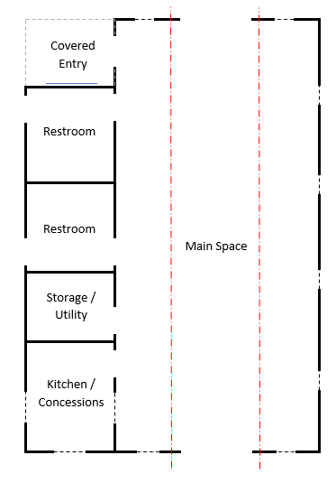
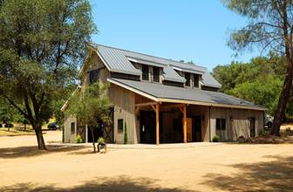
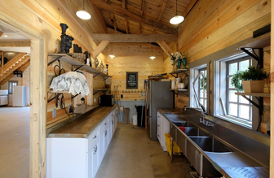

Slide 22
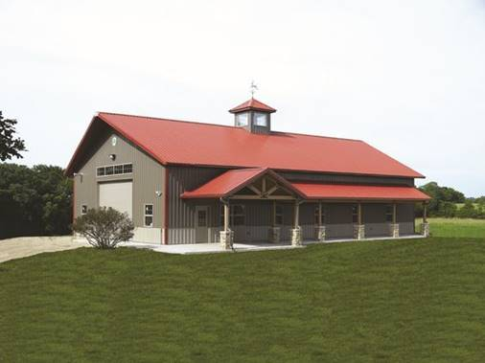

Slide 23
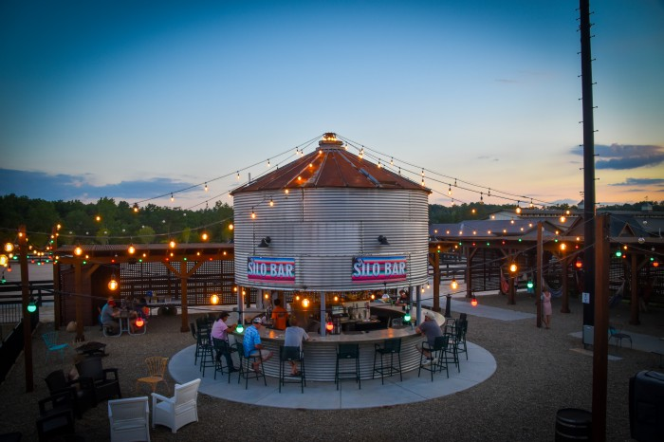
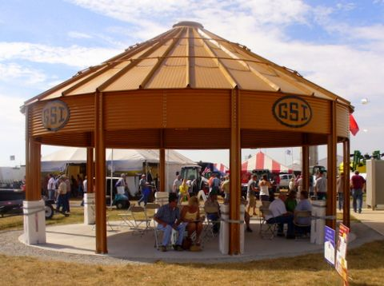

Slide 25
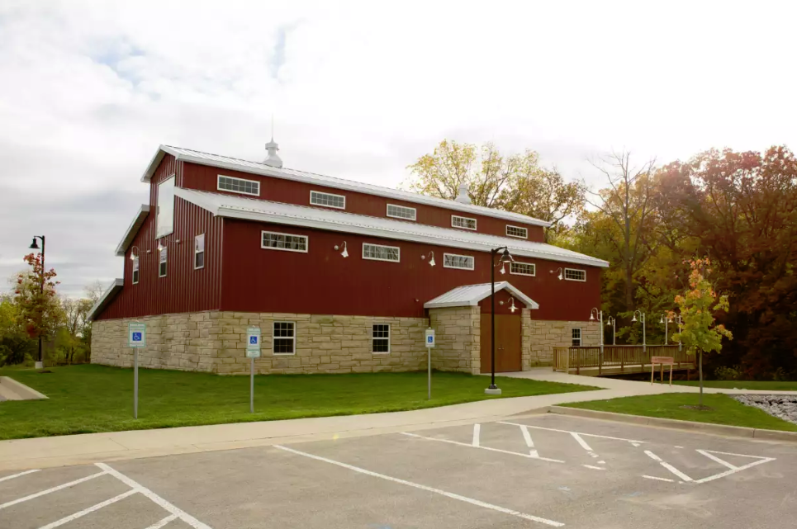

Slide 27
Things Needed to Move Forward
5-8 Leaders for Public/Private Steering Committee
Determine Viability
Finalize Design/Cost
Determine Funding Approach
Fundraise Necessary Funds

Slide 28
Support Already Inspired:
Architect Provided Initial Design
Fundraisers
Nate Curry, Bob Hundhausen, and Ron Weier have already agreed to help fundraise.
Challenge Match Pledges $160,000
City - $50,000
Area Entity - $10,000
Anonymous Donor - $100,000

Slide 29
Additional Support Offered:
Inspiring Community
Grants
Will provide grant writer to write grant requests
Will network with grantor to encourage approval
Fundraising:
Will mentor Steering Committee and Fundraising Chair as desired

Slide 30
Additional Support Offered:
Inspiring Community
Administration
Will print and mail your fundraising mailing
Will be the Non-Profit -501c(3) accepting & receipting checks
Send Thank Yous
Pay Bills

Slide 31
Questions/Comments

Slide 32
Next steps…
Form a steering committee to….
Determine Replacement Viability (is there support – time, talent & resources)
Receive steering committee report/recommendation by Sat. Nov. 10th
For Replacement – steering committee would continue work in 4th quarter of 2018 to…
Finalize Design/Cost
Develop funding and construction timelines
Determine Funding Approach – is a ‘community build’ possible?
Work with development committee/fund raisers to accumulate necessary funds and/or ‘gifts-in-kind’

Slide 33
Next steps…
PLEASE COMPLETE THE FORM
Gauging your interest/level of involvement and/or support
Asking about others who could/should be involved.
RETURN THE FORM TO ANGIE, LUKE, GENE OR BARB – HOPEFULLY AS YOU DEPART

Slide 34
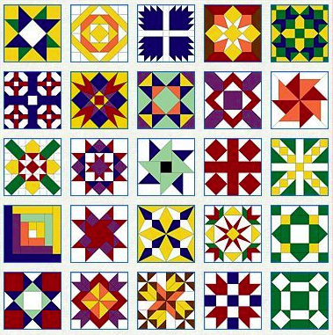
Thank you for coming!
Gene Weber: 608-778-6914
geneweber4@gmail.com
Angie Wright: 608-778-9652
angie.wrightwi@gmail.com
Barb Daus: 608-348-3365
barbdaus@gmail.com
Luke Peters: 608-348-1827
petersl@platteville.org

