Slide 1
Camp Street Water and Sewer Replacement Public Information Meeting
January 16, 2024 @ 7:00 PM
Presented by:
Howard Crofoot, P.E. – Director of Public Works
Dan Dreessens, P.E. – Project Engineer

Slide 2
Agenda of Meeting:
Overview of the Project
Overview of the Work that will Typically be Completed for Your Property
Preliminary Schedule for the Project
Answer General Questions
End General Presentation and Answer Individual Questions

Slide 3
Project Contacts
City of Platteville:
Howard Crofoot, P.E.
Director of Public Works
608-348-9741, ext. 2240
Email: Crofooth@Platteville.org
Clinton Langreck
City Manager
Delta 3 Engineering:
Dan Dreessens, P.E.
Project Engineer
608-348-5355, ext. 1002
Email: dan@delta3eng.biz
Brice Piotrowski, ext. 1042
Design Engineer

Slide 4
2024 City of Platteville Projects

Slide 5
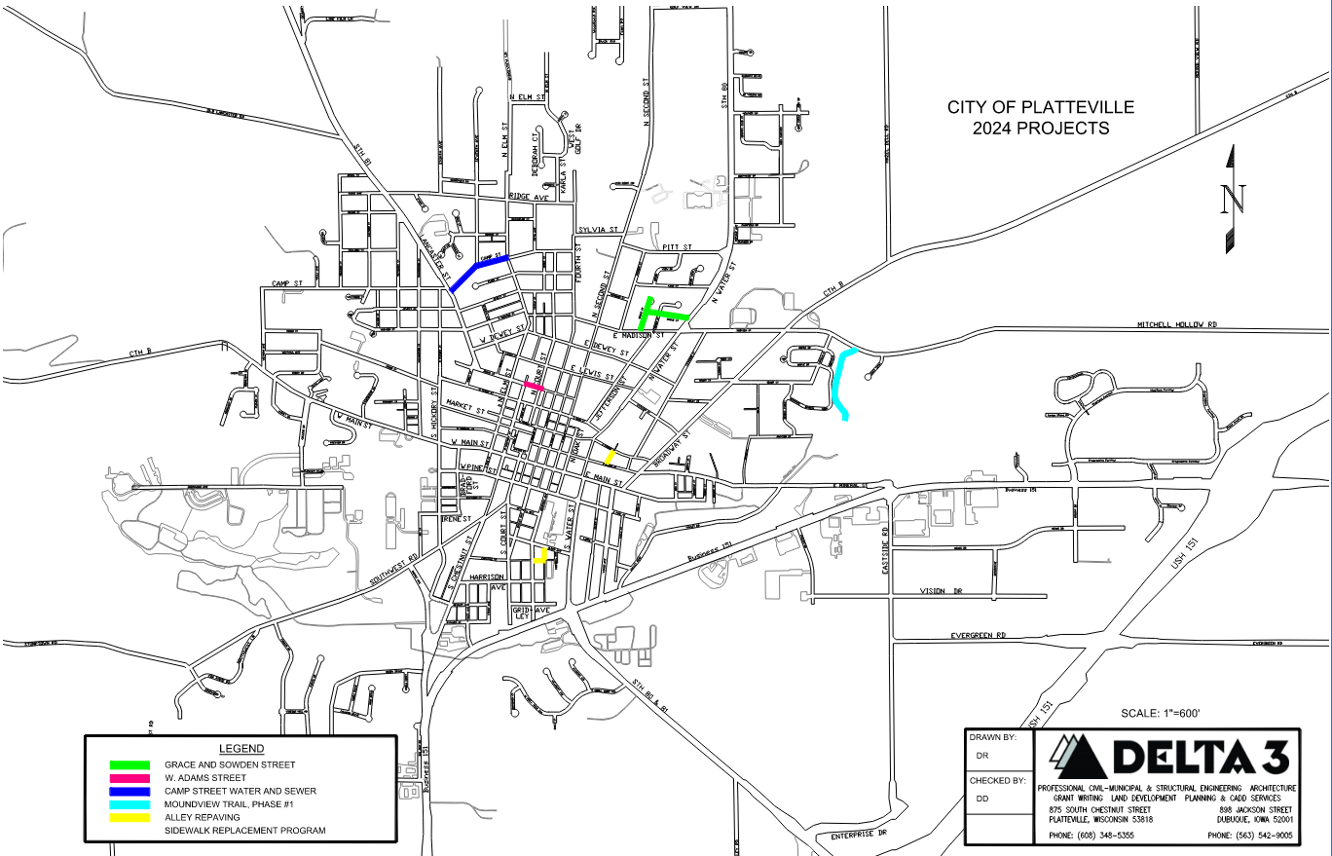
2024 Project Locations

Slide 6
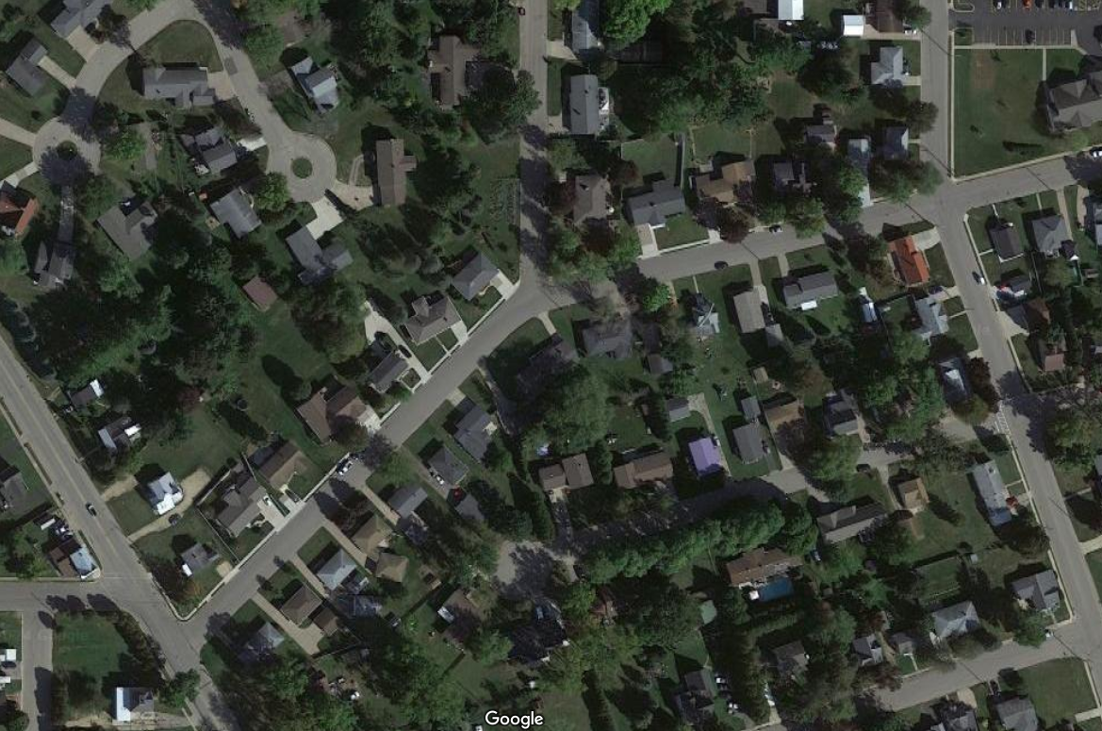
Camp Street
SEVENTH AVENUE
CAMP ST.
ELM STREET
LANCASTER STREET
CAMP STREET
CAMP ST.

Slide 7
Project Details:
Replacing Sanitary Sewer and Laterals
Replacing Water Main and Services
Temporary pavement, sidewalk, etc. until 2025
Full Street Reconstruction in 2025 (WisDOT)
Budget = $595,000

Slide 8
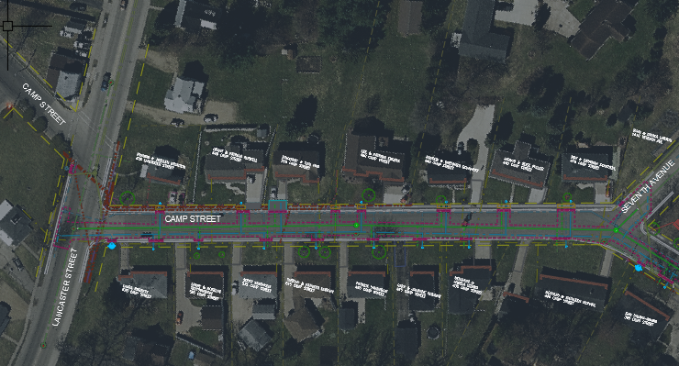
Lancaster Street to Seventh Avenue:
8” Water Main and 8” Sanitary Sewer
Hydrant at SE corner of Lancaster and Camp
Patch pavement, curbs, sidewalks, and driveways

Slide 9
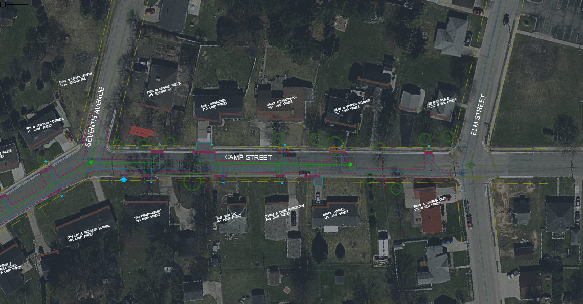
Seventh Avenue to Elm Street:
10” Water Main and 8” Sanitary Sewer
Hydrant at SE corner of Lancaster and Camp
Patch pavement, curbs, sidewalks, and driveways

Slide 10
Water & Sewer Laterals
City’s Contractor will be replacing the City’s portion of your water service and
sewer lateral:
You have the option of hiring your own contractor to replace your lateral(s)
from the sidewalk to your house

Slide 11
Water & Sewer Laterals
Other notes on laterals:
Your sewer lateral will be televised to check for condition
If an issue (sag, poor condition, roots, etc.) is found you will be notified
You are not required to replace, this is for information only
If you choose to replace, it will be at your expense
If your water service is in bad condition, City personnel will
notify you
You are not required to replace, this is for information only
If you choose to replace, it will be at your expense
Some of the services may still be lead (known or unknown)
Per City’s website, none are listed as lead
If additional found, will inform property owner
You are not required to replace a lead service but are strongly
encouraged to do so
There will be funds available to assist with private side replacement, City is currently working with DNR on this.

Slide 12
Water Outages
During construction there will be several planned water outages:
There will be a 24-hour notice
They will be planned for during the day
Typically, they will last all day long
Plan on 2 to 3 for each project
1 final water outage when your water service is replaced
Contractor will try to notify the night before or the morning of
Typically, will only last a couple of hours
Emergency water outages:
This is a construction project
There is the possibility that a water main or service is accidently
damaged
Contractor/City will repair as soon as possible
Under no circumstance will the contractor be allowed to leave the job
without turning the water back on, unless they have received
permission from project engineer to do so
If you do not have water and you do not see anyone working, please
notify the on-site inspector or City as soon as possible!

Slide 13
Other Utility Outages
Alliant Energy:
Responsible for natural gas and electric
May be replacing gas lines and electric lines now or in 2025
Will be responsible for notifying customers of outages
CenturyLink/Astrea:
Responsible for telephone/fiber optic
May be moving lines/poles now or in 2025
May still be working on fiber optic upgrade
Will be responsible for notifying customers of outages

Slide 14
Curb, Sidewalk, and Driveway Replacement
Will temporarily replace until fully replaced in 2025
Asphalt, concrete, or combination of both

Slide 15
Tree Removal
We have preliminarily identified trees that may need to be removed due to utility work
If you think your tree will be damaged, please let us know as soon as
possible
If your tree is removed, there is a reimbursement program through the
City of Platteville to replace the tree(s) – but only if it was required to
be removed as part of the project
Additional trees may be identified to be removed. We will contact you as
soon as we know that your tree will need to be removed.
2025 Project and/or utility companies may need to remove additional trees as part of their project.

Slide 16
Access During Construction
There will be absolutely NO THRU TRAFFIC
There are side streets for all of the projects for non-local traffic to navigate around the projects
For local traffic, the intersections will be open
There will be times when you will be unable to access your driveway:
Installation of water and sanitary sewer on your block
Pavement patching
When there isn’t construction on your block you can park in your driveway
Should be able to access your driveway each evening unless need to replace part of the driveway
Please check the City’s website and social media sites for updates

Slide 17
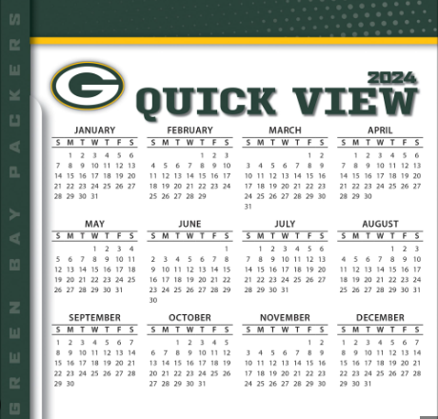
2024 Project Schedule:
Water and Sewer Project will be bid out in mid-March 2024
Council will award the project to the lowest, responsible bidder in March 2024
Construction will start in May 2024
After public schools spring semester ends
Construction will be completed in August 2024
Before public schools fall semester starts
Street will be fully reconstructed in 2025

Slide 18
COMMUNICATION!!!!
IS THE KEY TO A SUCCESSFUL PROJECT
If you have questions before the project, contact: (cards by sign-in sheet)
Dan Dreessens or Brice Piotrowski, Delta 3 Engineering
Howard Crofoot, City of Platteville
If you have questions during the project, contact:
Dan Dreessens, Delta 3 Engineering
Delta 3 Engineering’s on-site inspector
Howard Crofoot, City of Platteville
Project’s contractor (TBD)
Delta 3 Engineering will have an on-site inspector present 75%+ of the time
There will be a second public information meeting in May 2024 for
the project once the contractor(s) has been selected.
Monthly construction meetings will also be held during construction.

Slide 19
ANY GENERAL
QUESTIONS?

Slide 20
FOR ATTENDING

