Slide 1
Sowden Street & Grace Street Reconstruction Project Public Information Meeting
January 16, 2024 @ 6:00 PM
Presented by:
Howard Crofoot, P.E. – Director of Public Works
Dan Dreessens, P.E. – Project Engineer

Slide 2
Agenda of Meeting:
Overview of the Project
Overview of the Work that will Typically be Completed for Your Property
Preliminary Schedule for the Project
Answer General Questions
End General Presentation and Answer Individual Questions

Slide 3
Project Contacts
City of Platteville:
Howard Crofoot, P.E.
Director of Public Works
608-348-9741, ext. 2240
Email: Crofooth@Platteville.org
Clinton Langreck
City Manager
Delta 3 Engineering:
Dan Dreessens, P.E.
Project Engineer
608-348-5355, ext. 1002
Email: dan@delta3eng.biz
David Thering, ext. 1031
Design Engineer

Slide 4
2024 City of Platteville Projects

Slide 5
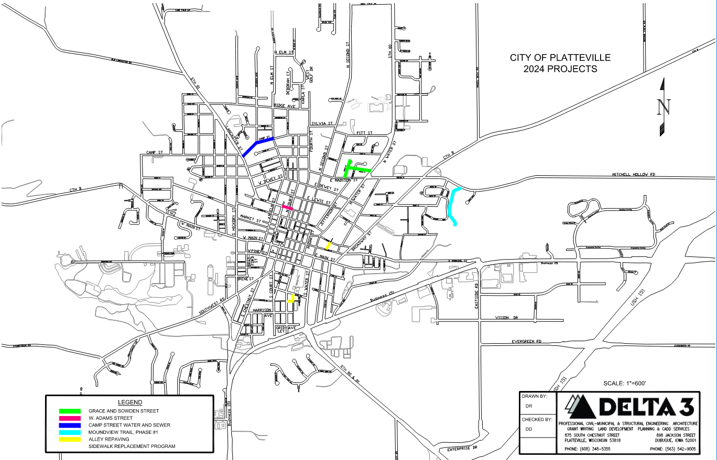
2024 Project Locations

Slide 6
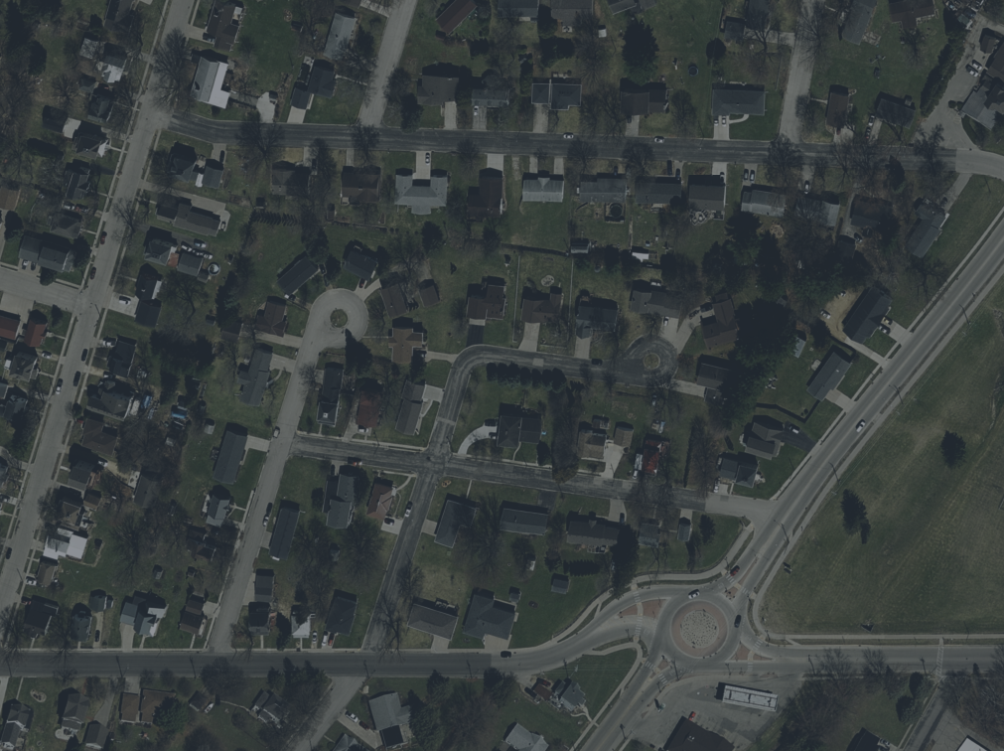
Grace Street & Sowden Street
MOUND VIEW
DRIVE
MOUND VIEW
COURT
KASE STREET
SIETMERS STREET
WATER STREET
GRACE STREET
SOWDEN STREET
JEFFERSON STREET
MADISON STREET

Slide 7
Project Details:
Length of Project = 1,300’
Width: 32’
Sidewalk:
ADD sidewalk on west side of Grace by 800 Grace
ADD sidewalk on north side of Sowden by 460 Grace and 870 Water Street
Utility Reconstruction:
Replace Water & Sanitary Sewer
Replace Storm Sewer
Street Reconstruction
Replace gravel base
Replace curb and gutter
Replace asphalt pavement
Budget = $1,685,000

Slide 8
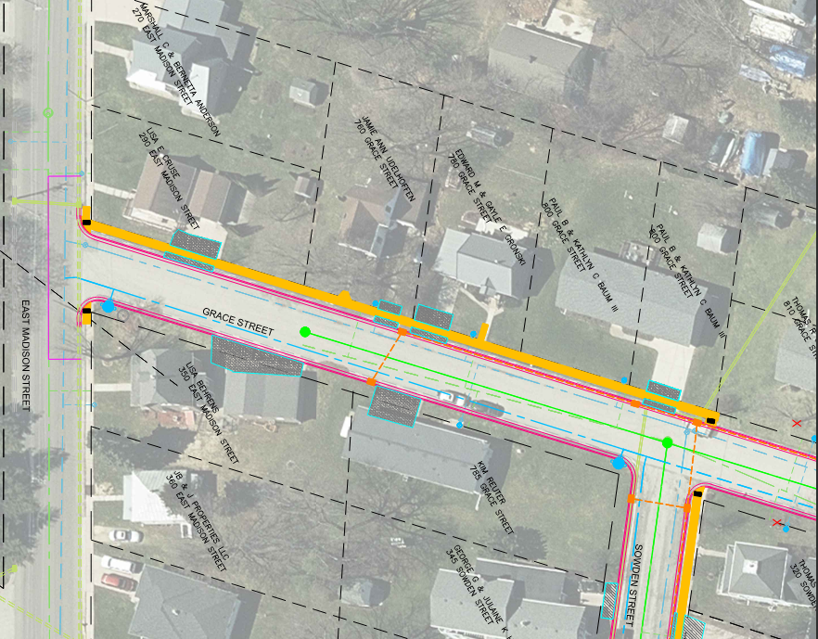
Street Width = 32’
Add sidewalk in front of 800 Grace Street
ADA crossing at Sowden Street

Slide 9
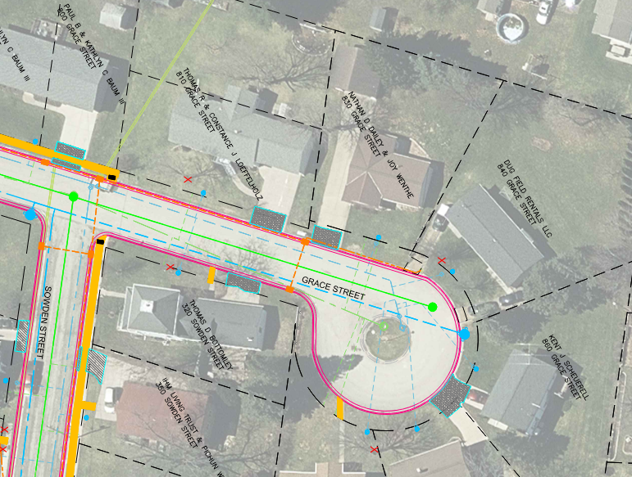
Street Width = 32’
Eliminate center island in cul-de-sac
No sidewalk

Slide 10
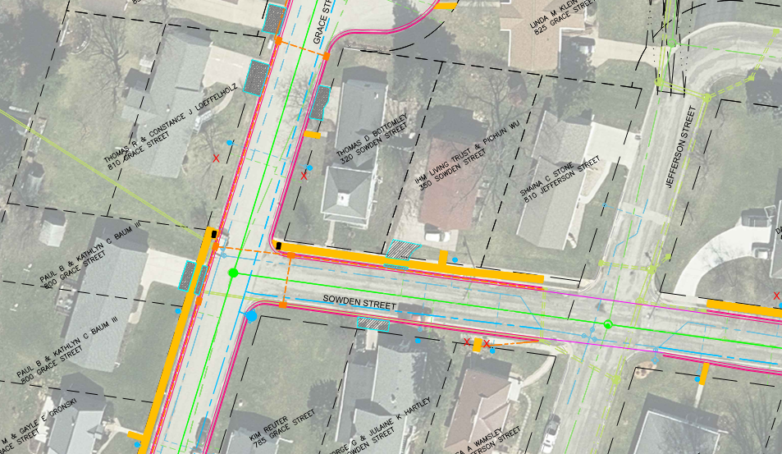
Street Width = 32’
ADA crossing at Grace Street
Repave Sowden and Jefferson intersection

Slide 11
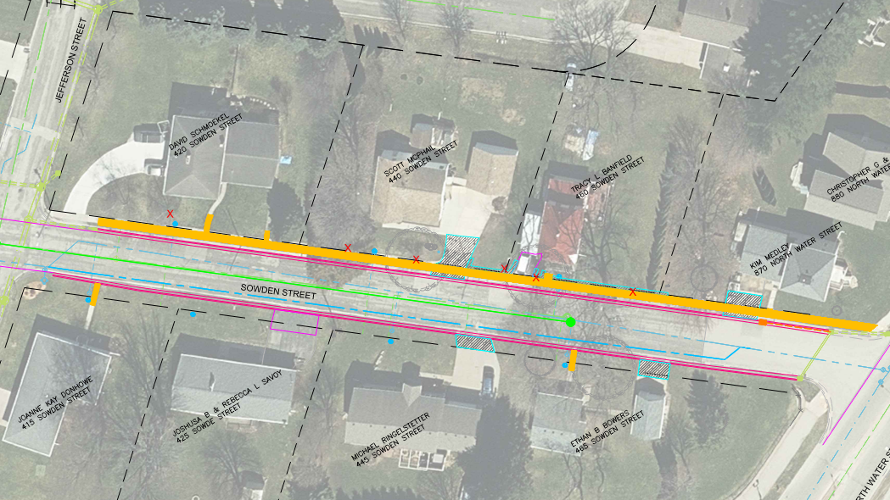
Street Width = 32’
Complete sidewalk along north side of street
Potential retaining walls by new sidewalk

Slide 12
Water & Sewer Laterals
City’s Contractor will be replacing the City’s portion of your water service and
sewer lateral:
You have the option of hiring your own contractor to replace your lateral(s)
from the sidewalk to your house

Slide 13
Water & Sewer Laterals
Other notes on laterals:
Your sewer lateral will be televised to check for condition
If an issue (sag, poor condition, roots, etc.) is found you will be notified
You are not required to replace, this is for information only
If you choose to replace, it will be at your expense
If your water service is in bad condition, City personnel will
notify you
You are not required to replace, this is for information only
If you choose to replace, it will be at your expense
Some of the services may still be lead (known or unknown)
Per City’s website, 780 Grace and 465 Sowden are still lead on private side
If additional found, will inform property owner
You are not required to replace a lead service but are strongly
encouraged to do so
There will be funds available to assist with private side replacement, City is currently working with DNR on this.

Slide 14
Water Outages
During construction there will be several planned water outages:
There will be a 24-hour notice
They will be planned for during the day
Typically, they will last all day long
Plan on 2 to 3 for each project
1 final water outage when your water service is replaced
Contractor will try to notify the night before or the morning of
Typically, will only last a couple of hours
Emergency water outages:
This is a construction project
There is the possibility that a water main or service is accidently
damaged
Contractor/City will repair as soon as possible
Under no circumstance will the contractor be allowed to leave the job
without turning the water back on, unless they have received
permission from project engineer to do so
If you do not have water and you do not see anyone working, please
notify the on-site inspector or City as soon as possible!

Slide 15
Other Utility Outages
Alliant Energy:
Responsible for natural gas and electric
May be replacing gas lines and electric lines
Will be responsible for notifying customers of outages
CenturyLink/Astrea:
Responsible for telephone/fiber optic
May be moving lines/poles
May still be working on fiber optic upgrade
Will be responsible for notifying customers of outages
Will work with both utilities on moving their facilities so do not interfere with
street, sidewalks, storm sewer, and sanitary sewer.

Slide 16
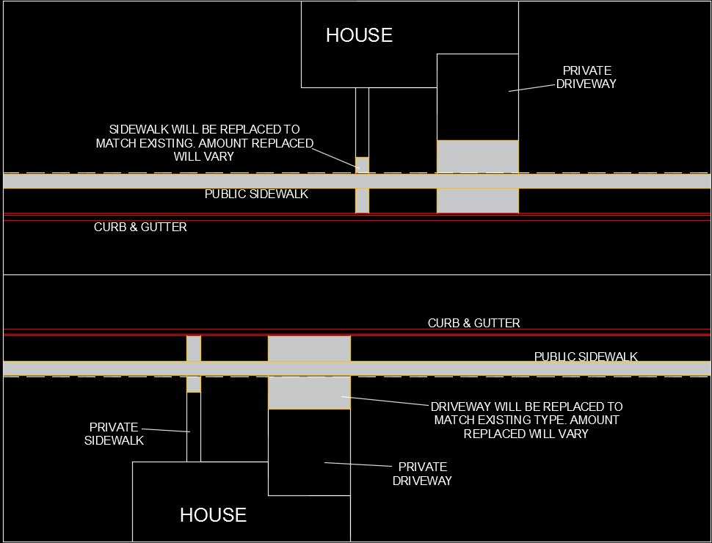
Curb, Sidewalk, and Driveway Replacement
City’s Contractor will be replacing the curb and gutter, sidewalks (if
applicable), and driveways in order to match the new street into your
property

Slide 17
Curb, Sidewalk, and Driveway Replacement
(cont.)
You have the option to hire your own contractor to finish replacing your private driveway or sidewalk, before, during, or after construction.
City’s contractor may not be interested in doing private work!
If you choose to have work done on your property, please let us know so that we can coordinate the City’s work with yours!
Driveways will be replaced to existing width. If you would like a wider driveway, the City will consider this on a case-by-case basis.
Driveways will be replaced to match existing material type.
Driveways (replaced by City’s contractor) will be required to be 6 inches thick with reinforcement.
City’s contractor will be responsible for final grading of lawn areas, placement of black dirt, and reseeding as necessary.

Slide 18
Public Right-of-Way Accessibility Guidelines (PROWAG)
Recommendation of 5’ sidewalk OR 4’ wide sidewalk with a passing “Lane” of 5’x5’ every 200’
Can use an intersection, driveway, or carriage walk as the passing “Lane”
Maximum of 2% cross-slope at passing “Lane”
For Grace Street and Sowden Street, all sidewalks will be 4’ in width so will require passing “lane”

Slide 19
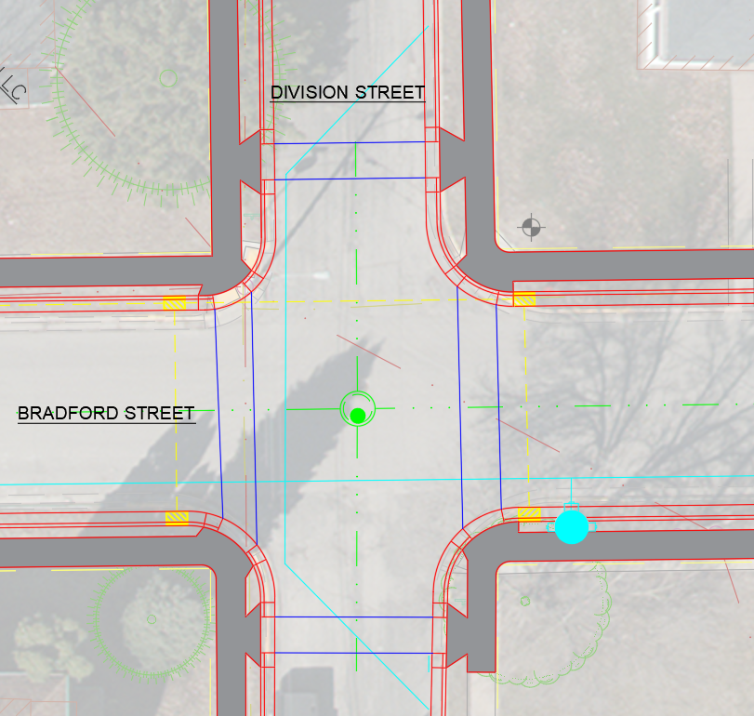
Public Right-of-Way Accessibility Guidelines Continued (PROWAG)
The handicap ramp crossings are offset due to the tight radii at the intersection corners
Offsetting the ramps allows for the required turning space

Slide 20
Tree Removal
We have preliminarily identified trees that may need to be removed due to sidewalk, street, or utility work
If you think your tree will be damaged, please let us know as soon as
possible
If your tree is removed, there is a reimbursement program through the
City of Platteville to replace the tree(s) – but only if it was required to
be removed as part of the project
Additional trees may be identified to be removed. We will contact you as
soon as we know that your tree will need to be removed.
Utility companies may need to remove additional trees as part of their
relocation project. They will be contacting you directly.

Slide 21
Access During Construction
There will be absolutely NO THRU TRAFFIC
There are side streets for all of the projects for non-local traffic to navigate around the projects
For local traffic, the intersections will be open
There will be times when you will be unable to access your driveway:
Installation of utilities (water, sanitary sewer, storm sewer, etc.) on your
block
Street excavation on your block
Installation of curb & gutter and sidewalk
Driveway replacement – a portion of your driveway will be replaced to
match into the new curb & gutter
Pavement replacement
Park on the side streets and walk to your residence during construction on
your block
When there isn’t construction on your block you can park in your driveway
Please check the City’s website and social media sites for updates

Slide 22
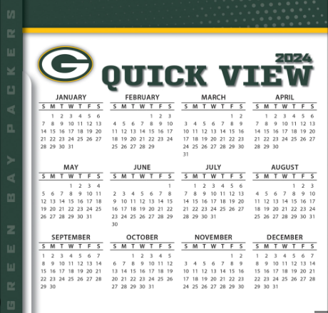
2024 Project Schedule:
Project will be bid out in mid-March 2024
Council will award the project to the lowest, responsible bidder in April 2024
Construction will start in May 2024
Underground utilities will be installed May - August
Street excavation, curb & gutter, paving, etc. will be completed August - October
Construction will be completed in October 2024
There may be some items (i.e. landscaping) that will need to be checked and, if necessary, replaced in Spring 2025

Slide 23
COMMUNICATION!!!!
IS THE KEY TO A SUCCESSFUL PROJECT
If you have questions before the project, contact: (cards by sign-in sheet)
Dan Dreessens or David Thering, Delta 3 Engineering
Howard Crofoot, City of Platteville
If you have questions during the project, contact:
Dan Dreessens, Delta 3 Engineering
Delta 3 Engineering’s on-site inspector
Howard Crofoot, City of Platteville
Project’s contractor (TBD)
Delta 3 Engineering will have an on-site inspector present 75% of the time
There will be a second public information meeting in April or May 2024 for
the project once the contractor(s) has been selected.
Monthly construction meetings will also be held during construction.

Slide 24
ANY GENERAL
QUESTIONS?

Slide 25
FOR ATTENDING

